Slide 1


AN EFFICIENT AND INTELLIGENT DECISION MAKING FOR
ECO-FERTILIZATION

Slide 2

ORIENTAL COLLEGE OF TECHNOLOGY DEPARMENT OF COMPUTER SCIENCE AND ENGINEERING ECO-FERTILIZATION PROJECT SUPERVIESED BY: PROJECT DEVELOPED BY: PROF. RAMEEZ ALI SIR 1. NEHA KUMARI(64) 2. PARIDHI SHRIVASTAVA(70) 3. RITIKA MAKHIJA(91) 4. TANUSHA THAKUR(115) ACADEMIC YEAR: 2022-2023 SESSION: JULY-DEC 2023

Slide 3
CONTENT
INTRODUCTION
OBJECTIVE OF PROJECT
TOOLS AND TECHNOLOGIES USED
METHODOLOGY
IMPLEMENTATION MODEL
DATA PREPARATION
DATA DESCRIPTION
IMPLEMENTATION ALGORITHM
RESULT
FUTURE SCOPE
CONCLUSION

Slide 4
INTRODUCTION
Fertilizer use is typically under the limited control of farmers. For the farmers to achieve higher yields and reduce fertilizer loss, competent guidance is required for the best use of these fertilizers.
This research presents nutrient recommendations using an updated iteration of the random forest algorithm which is based on time-series data to forecast the required quantity of nutrients for various crops by examining rainfall patterns and crop fertility.
The method suggested in this study, comes in handy for improving soil fertility by providing nutrients recommendations for optimum conditions for crop growth and reducing leaching and runoff potential.

Slide 5

OBJECTIVE OF PROJECT
To provide useful information for fertilizer use in terms of nutrients (NPK) by considering weather forecasts.
To reduce water pollution by slowing down the process of leaching.

Slide 6
TOOLS AND TECHNOLOGIES
Jupyter Notebook
Python
Matplotlib
HTML / CSS
Flask
VS Code

Slide 7
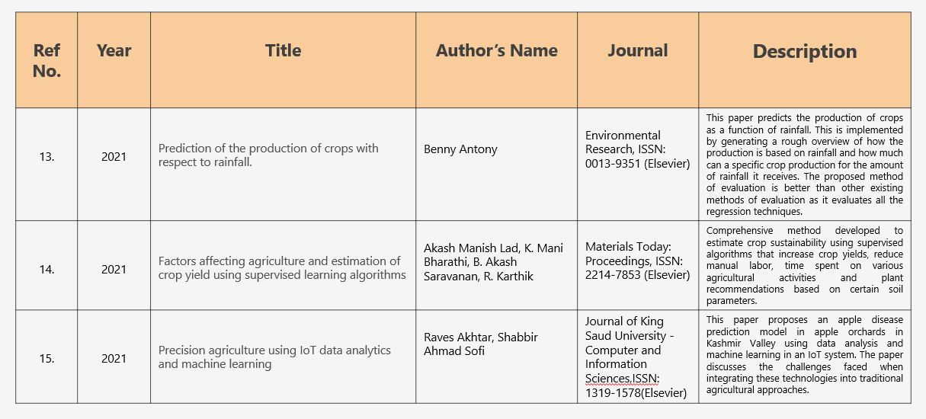
LITERATURE REVIEW

Slide 8
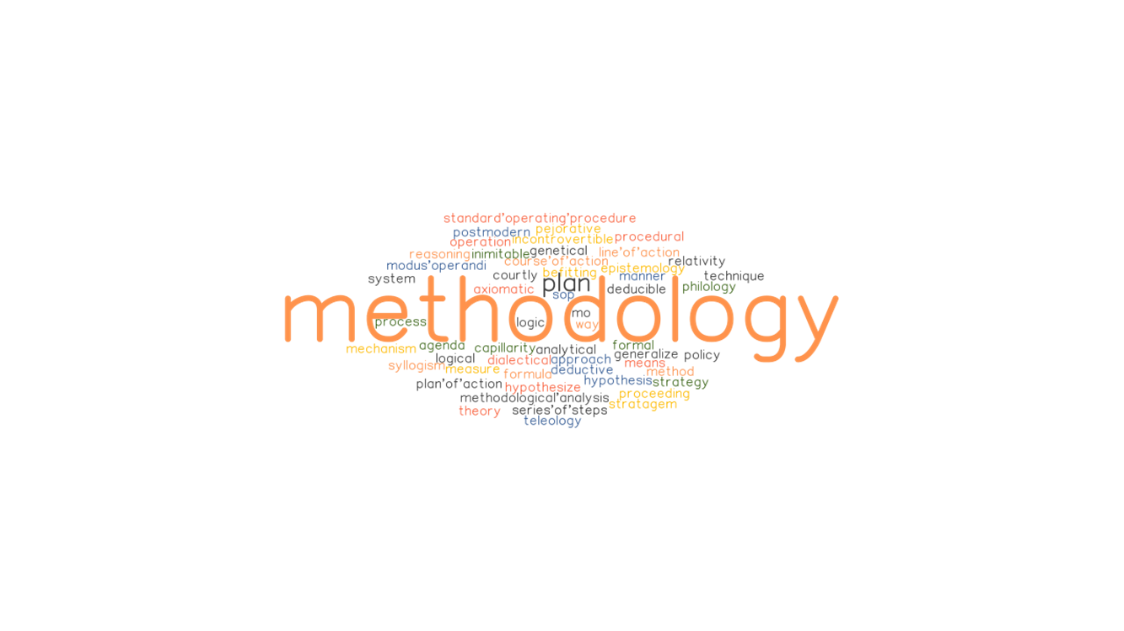
METHODOLOGY
In this study, a predictive model for the nutrients required for crops was obtained using random forest. Random Forest Regression represents the model with K-Fold Cross Validation technique and the model with acceptable accuracy for the prediction is then obtained. A total of 7 features have been used to evaluate the algorithm.
The algorithm requires input from the user (such as location and cropping). The location is fed to the Weather API which will return certain characteristics (e.g. temperature, humidity, rainfall) and if there is a possibility of heavy rainfall, a precautionary message is displayed to the user, otherwise the proposed algorithm is followed.

Slide 9
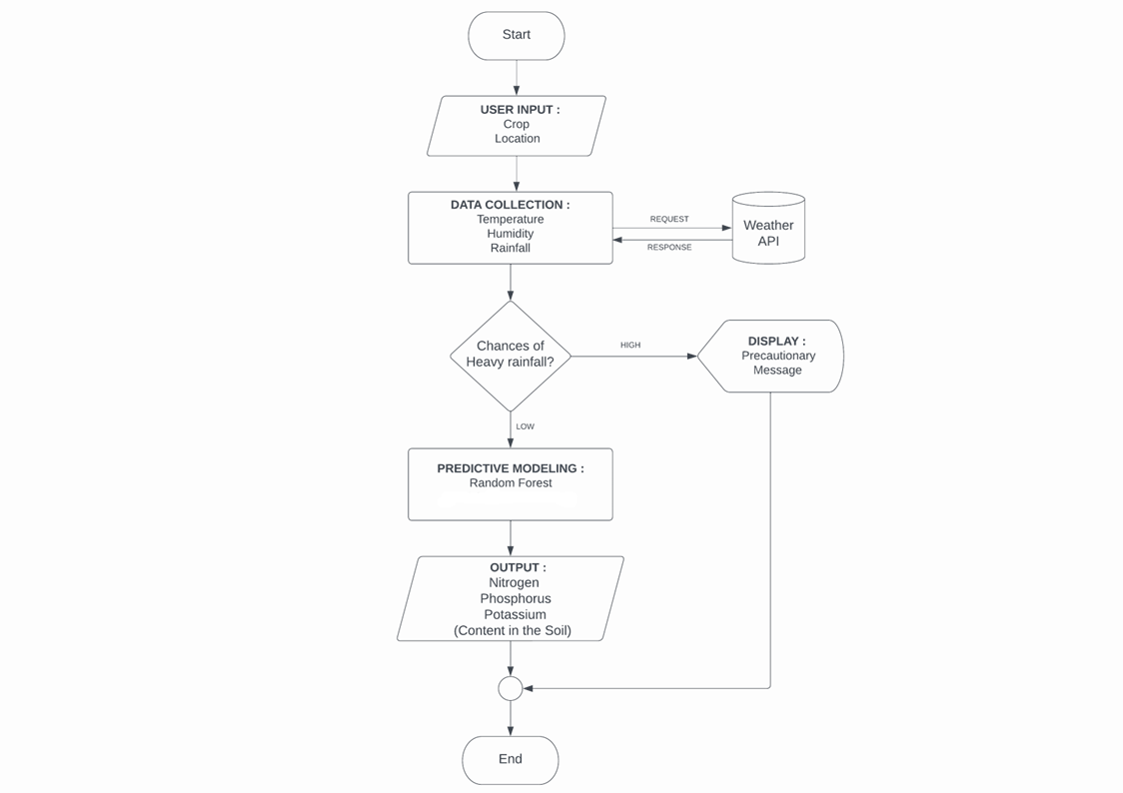
IMPLEMENTATION MODEL

Slide 10
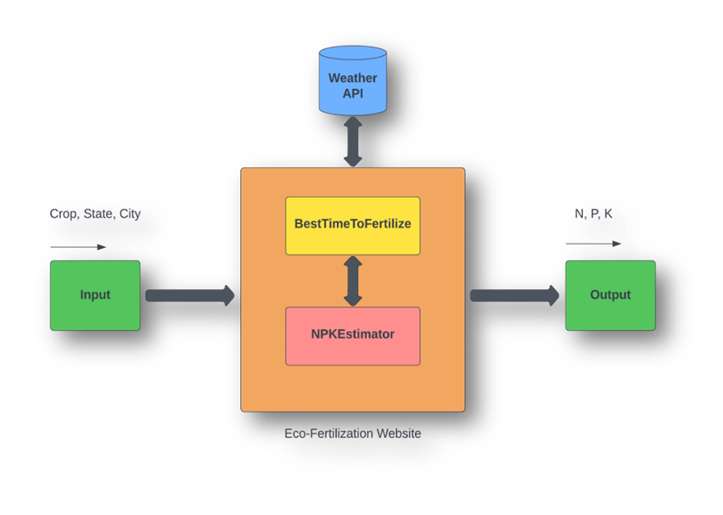
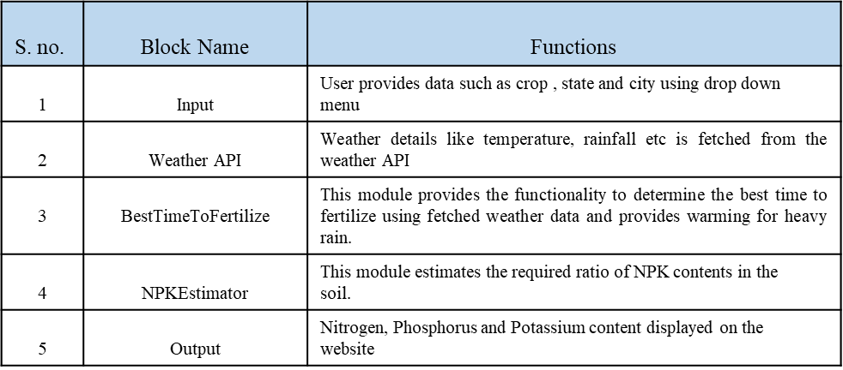
IMPLEMENTATION MODEL
System architecture is a conceptual model that defines the structure and behavior of the system. It comprises of the system components and the relationships describing how they work together to implement the overall system. The Figure shows the system’s architecture and the various components added to them.
The description of each component from the block diagram and their major functionalities with respect to the Eco-Fertilization as a complete unit is described in the table below.

Slide 11
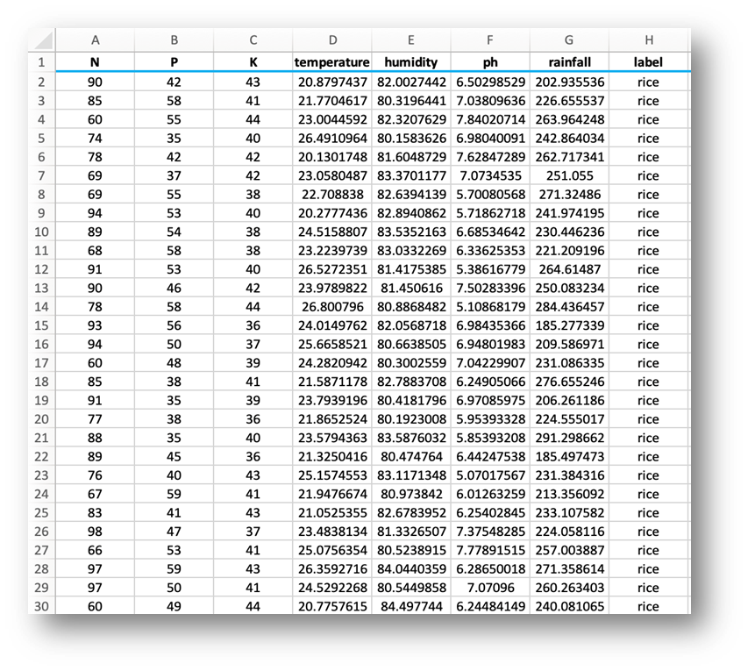
DATA PREPARATION
Actual data:
Crop Recommendation Dataset [23]

Slide 12
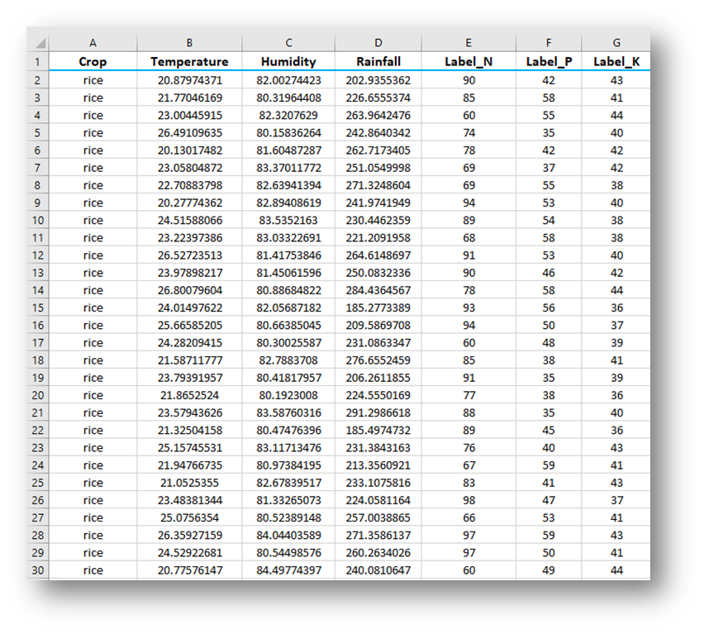
DATA PREPARATION
Actual Dataset contains 8 features. All of the features are not useful for proposed model. Therefore, a dimension reduction technique called feature selection is applied and seven features, then selected for evaluation
Customized Dataset

Slide 13
DATA DESCRIPTION
Input Features:
Crop : rice, cotton, etc.
Temperature : temperature in degree Celsius
Humidity : relative humidity in percentage
Rainfall : rainfall in mm
Output Features:
Label_N : ratio of Nitrogen content in soil
Label_P : ratio of Phosphorous content in soil
Label_K : ratio of Potassium content in soil

Slide 14
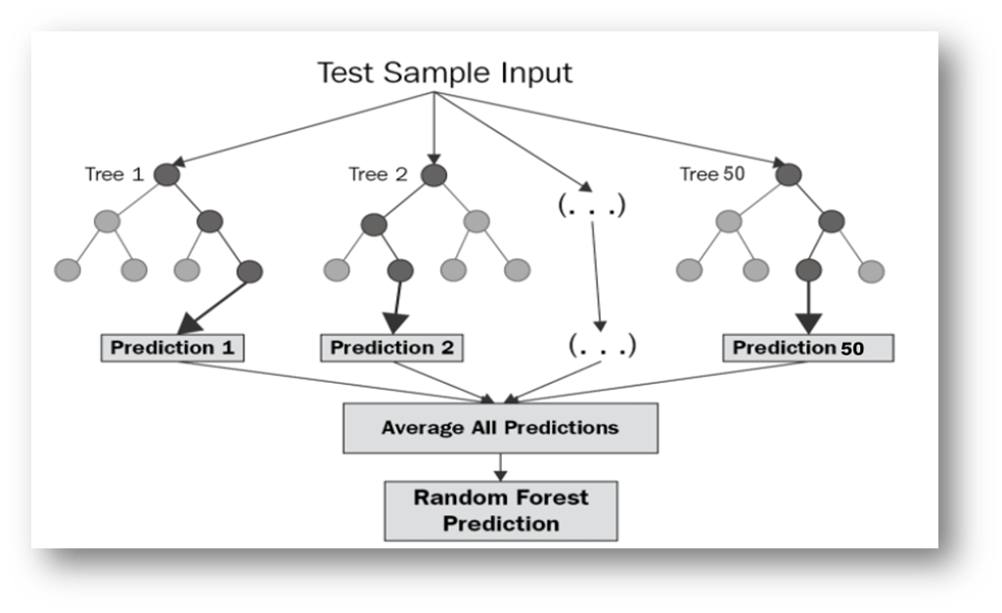
IMPLEMENATION ALGORITHM
Random forest (RF) is a collection of multiple decision trees that have variable hyper-parameters and are trained using varying subsets of data.
In our project , we are going to take crop and location as input, and based on it, we will predict the value of N, P, and K.
First, we will divide our dataset into training and test datasets, where the training dataset is 80% of the original data and the rest 20% is test data.
Then we will create three different random forests of size 50 (decision tree) for each N, P, and K and outputs the mean of the classes as the prediction of all the trees, shown in Table
Random Forest Regression:

Slide 15
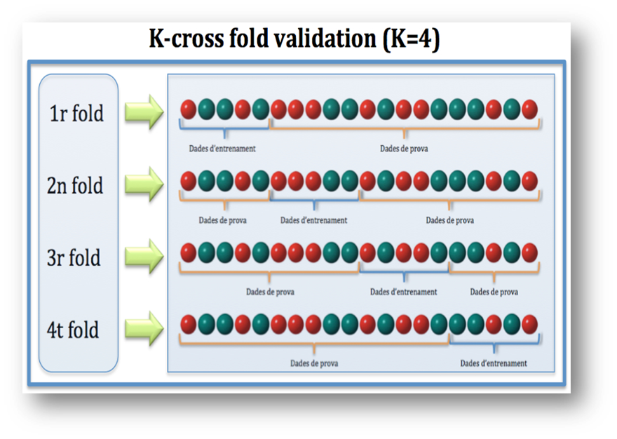
IMPLEMENTATION ALGORITHM
Cross-Validation:
Cross-validation is a resampling technique for testing machine learning models on a small set of data.
The algorithm has only one parameter, k, which determines how many groups a given data sample should be divided into. As a result, k-fold cross-validation is a common name for the procedure.
When a specific number for k is supplied, it can be used in place of k in the model's reference, such as k=4 for 4-fold cross-validation.

Slide 16
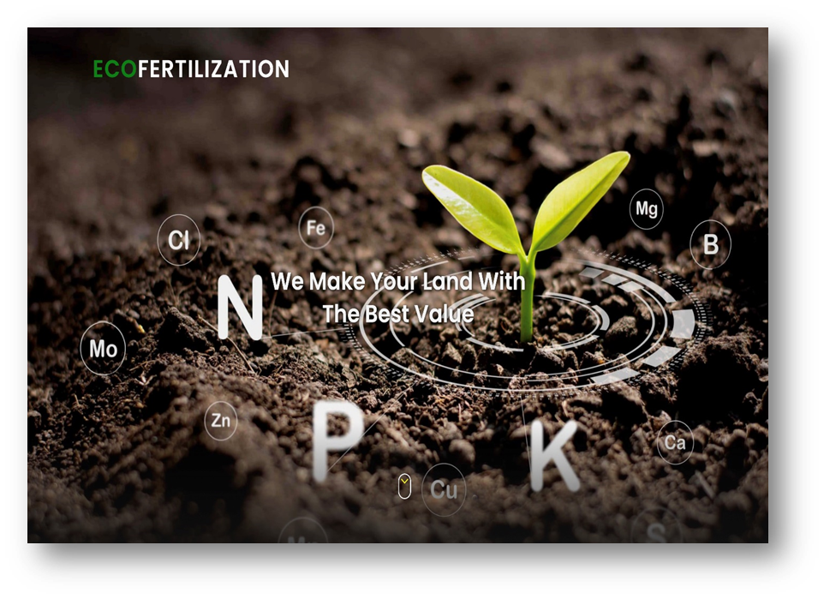

RESULT
Eco-Fertilization, a user-friendly system, has been implemented in the form of a website to provide cross-platform functionality and suggest appropriate timings and amount of nutrients required for an inputted crop with a heavy rainfall alert system (as shown in figures).

Slide 17
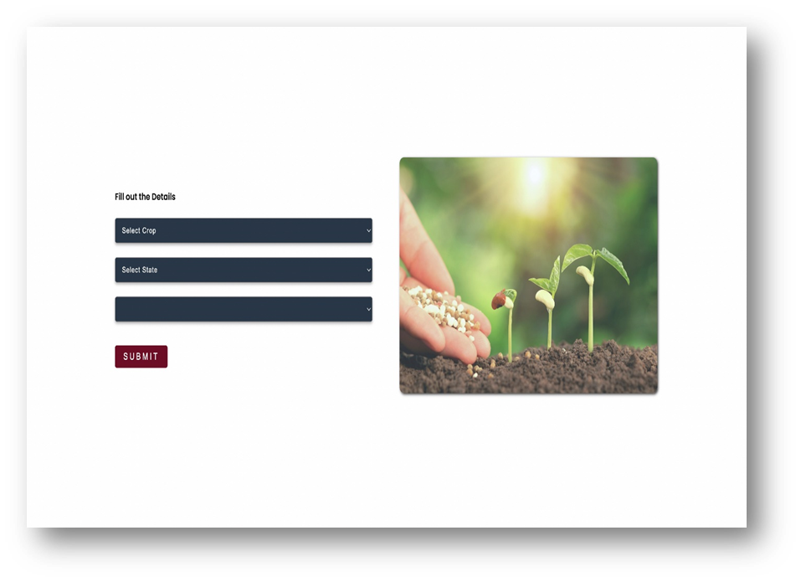
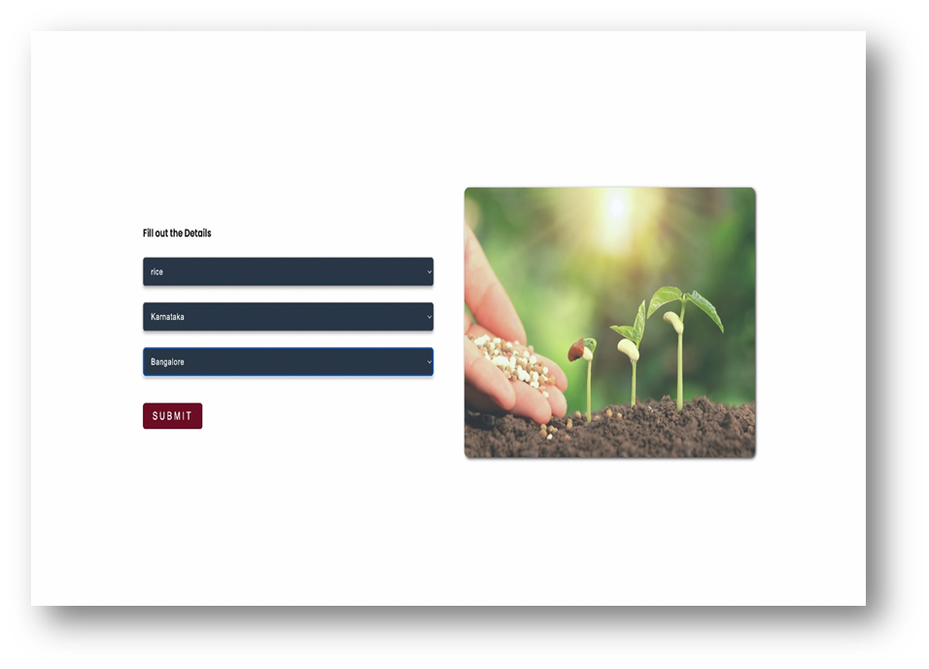
Input Form
Details filled using the drop-down menu

Slide 18

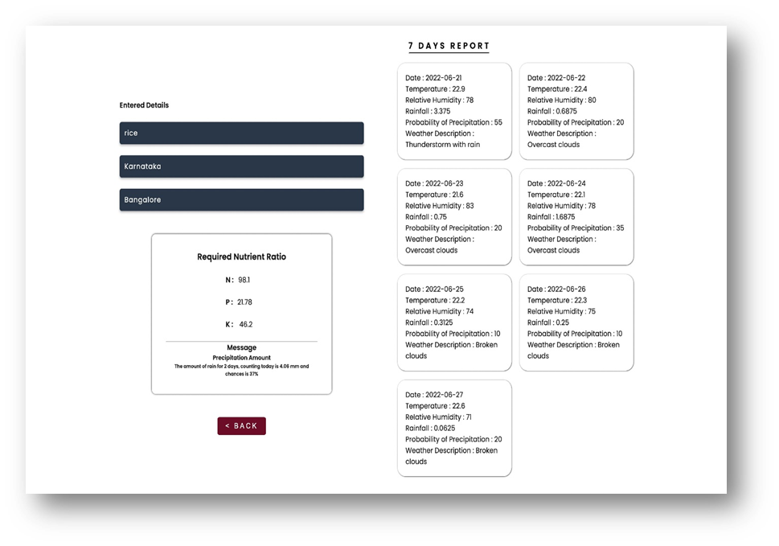
Applying Algorithm to inputted details
Output with seven days of weather forecasts & alerts/messages

Slide 19

FUTURE SCOPE
The proposed system provides a helping hand to our farmers. It gives information about the use and quantity of nutrients required by the crops. There is scope for improvement in the system by providing user interface in the native language, so that the user can operate the system easily if he or she is unfamiliar with the English language. In addition, speech recognition systems can be added to handle illiterate users

Slide 20

CONCLUSION
The proposed system is able to achieve 92% of accuracy, which is quite good for any predictive model. It provides information about the use and the amount of nutrients required by the crops for satisfactory crop growth and production with respect to weather conditions. It provides weather alerts and messages. Alerts are displayed in the output of this application in case of bad weather conditions. The accuracy can be improved further with development in technologies

Slide 21
APPLICATIONS
This project is useful in the agriculture sector.
Can be used to reduce the wastage of fertilizers.
Used to suggest nutrient recommendations for the crops.
It reduces water pollution by slowing down the process of soil leaching as fertilizers can reach the water table and contaminate shallow groundwater and deep aquifers.
Reduce leaching and runoff potential.
It provides weather alerts and messages. Alerts are displayed in the output of this application in case of bad weather conditions.
Seven-day weather forecasts to timely plan the fertilization.

Slide 22
REFERENCES
21] mtdtraining , “ https://www.mtdtraining.com/wp-content/uploads/2017/11/objective-setting.jpg ” (accessed on 6th April 2022)
[22] Grammartop, “ https://grammartop.com/wp-content/uploads/2020/11/methodology-488f1a23453770c85d6bba8200517e430312982e.png ” (accessed on 6th April 2022)
[23] Kaggle, “ https://www.kaggle.com/datasets/atharvaingle/crop-recommendation-dataset ” (accessed on 16th November 2021)
[24] futurescope , “ https://www.futurescope.ie/wp-content/uploads/2020/12/Logo.png” (accessed on 22nd June 2022)
[25] Dreamstime , “ https://thumbs.dreamstime.com/b/conclusion-conclusion-sign-conclusion-paper-origami-speech-bubble-conclusion-tag-conclusion-banner-124314194.jpg” (accessed on 21st June 2022)

Slide 23


